Slide 1
Cairo University CMPN451
Faculty of Engineering Spring 2022
Computer Engineering Department
Association Rules
Data Mining Course
4/5/2022
1
Notes:
1

Slide 2
Introduction
Association Rule:
Represents an association between the values of certain attributes and those of others.
Example:
If we have a financial dataset one of the rules extracted might be as follows: IF Has-Mortgage = yes AND Bank Account Status = In credit THEN Job Status = Employed AND Age Group =Adult under 65
4/5/2022
2

Slide 3
Applications
Marketing and Sales Promotion:
Let the rule discovered be {Bagels, … } --> {Potato Chips}
We can use this information in :
How to boost Potato Chips sales ?
What will happen if not selling Bagels any more ?
How we can use Bagels to promote sales ?
4/5/2022
3
Notes:
Potato Chips as consequent => Can be used to determine what should be done to boost its sales.
Bagels in the antecedent => Can be used to see which products would be affected if the store discontinues selling bagels.
Bagels in antecedent and Potato chips in consequent => Can be used to see what products should be sold with Bagels to promote sale of Potato chips!
3

Slide 4
Applications
Supermarket shelf management.
Analysis of items purchased by credit card.
Analysis of patients’ medical records.
Analysis of crime data.
Analysis of data from satellites.
4/5/2022
4

Slide 5
Association Rule Mining
There are large number of possible association rules for a given dataset.
However, a high proportion of these rules are of little (if any) value.
4/5/2022
5

Slide 6
Measure of rule interestingness
To distinguish between one rule and another we need some measures of rule quality !!! .
4/5/2022
6

Slide 7
Notation Used
If we have a rule in the form of
If LEFT then RIGHT
We define the following counters:
NLEFT Number of instances matching LEFT
NRIGHT Number of instances matching RIGHT
NBOTH Number of instances matching both LEFT and RIGHT
NTOTAL
4/5/2022
7

Slide 8
Basic Measures of Rule Interestingness
Confidence (A→B) = (Predictive Accuracy, Reliability)
The proportion of transactions that contain both left and right hand side items of the rule to the transactions containing left hand side items.
Nboth / Nleft
Example:
Transaction 1: {Cheese, Milk, Eggs}
Transaction 2: {Milk, Apples, Bananas, Eggs}
Transaction 3: {Cheese, Milk, Chocolate, Eggs}
Transaction 4: {Potato chips, Chocolate, Apples, Eggs}
Transaction 5: {Chocolate, Apples, Milk, Cheese}
Confidence (Milk → Cheese) = Nboth / Nleft = 3/4 = 0.75
4/5/2022
8
Notes:
8

Slide 9
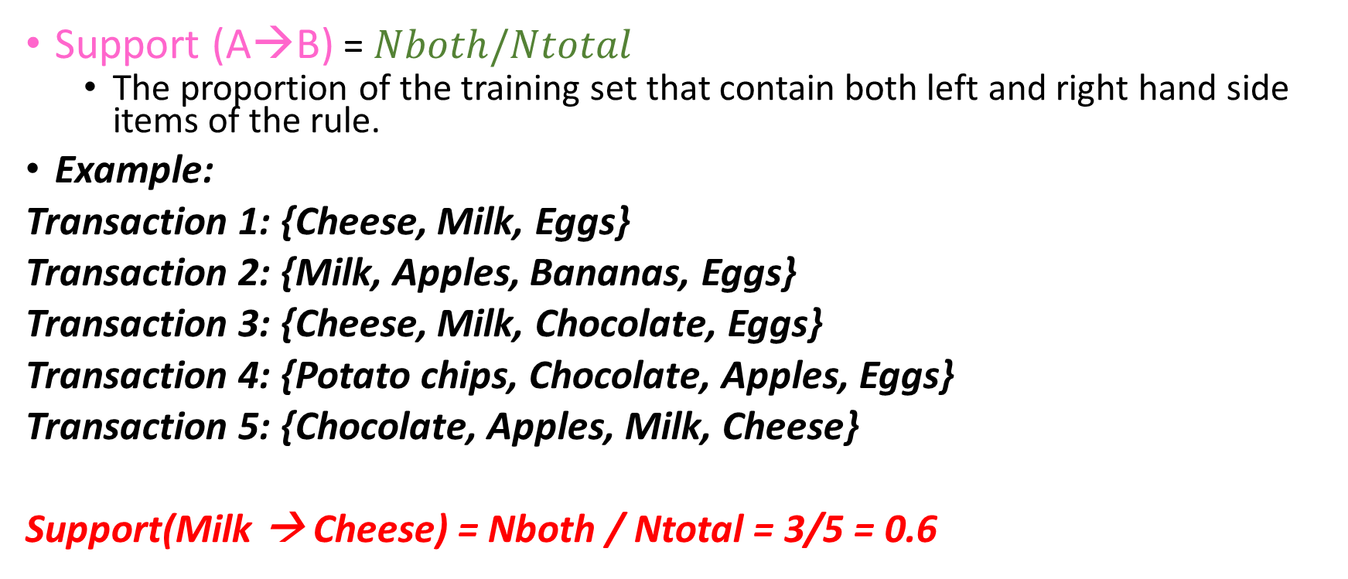
Basic Measures of Rule Interestingness
4/5/2022
9
Notes:
9

Slide 10
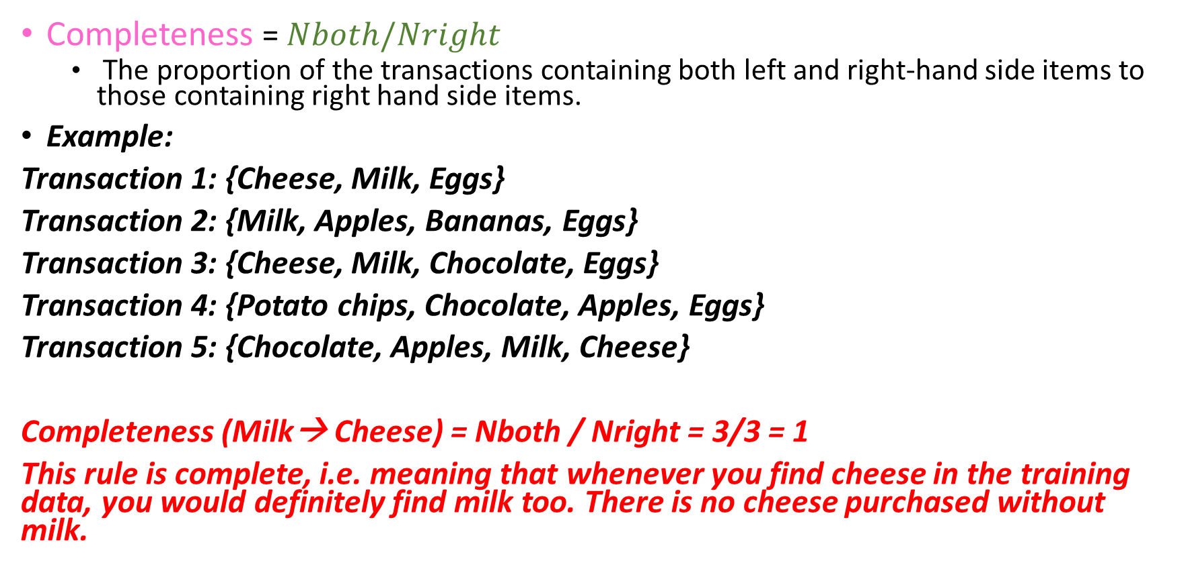
Basic Measures of Rule Interestingness
4/5/2022
10
Notes:
10

Slide 11
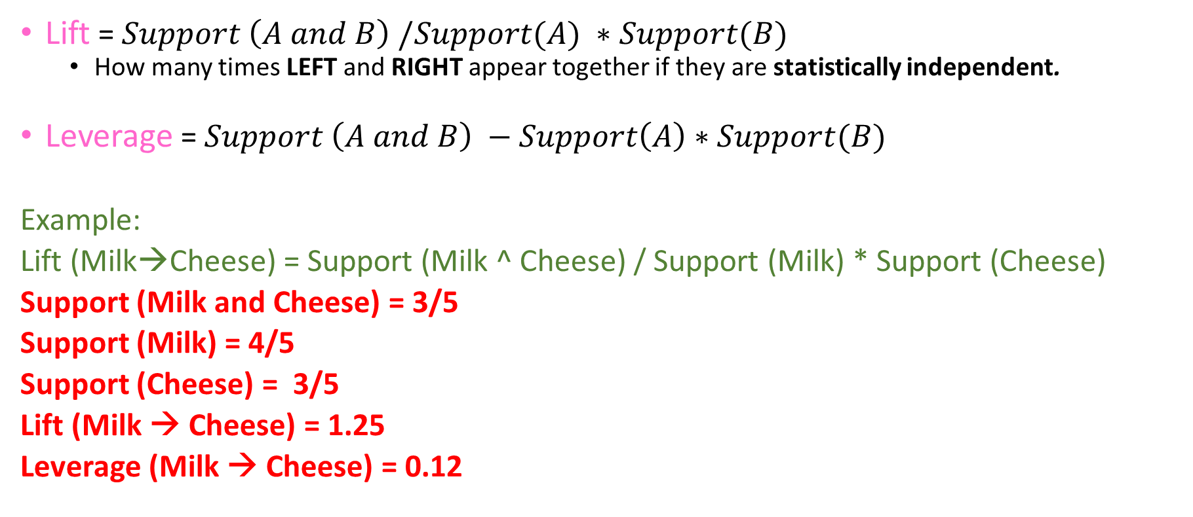
Basic Measures of Rule Interestingness
4/5/2022
11
Notes:
A lift value greater than 1 indicates that the rule body and the rule head appear more often together than expected, this means that the occurrence of the rule body has a positive effect on the occurrence of the rule head.
A lift smaller than 1 indicates that the rule body and the rule head appear less often together than expected, this means that the occurrence of the rule body has a negative effect on the occurrence of the rule head.
A lift value near 1 indicates that the rule body and the rule head appear almost as often together as expected, this means that the occurrence of the rule body has almost no effect on the occurrence of the rule head.
11

Slide 12
Example : Market Store
Transaction_Id | Time | Items_bought
101 | 6:30 | Milk, Bread, Cookies, Juice
792 | 7:35 | Milk, Juice
1130 | 8:05 | Milk, Eggs
1730 | 8:40 | Bread, Cookies, Coffee
4/5/2022
12

Slide 13
Example: Market Store
Transaction_Id | Time | Items_bought
101 | 6:30 | Milk, Bread, Cookies, Juice
792 | 7:35 | Milk, Juice
1130 | 8:05 | Milk, Eggs
1730 | 8:40 | Bread, Cookies, Coffee
Rule | NLEFT | NRIGHT | NBOTH | NTOTAL | Support | Confidence | Completeness
Milk → Juice | 3 | 2 | 2 | 4
Bread → Juice | 2 | 2 | 1 | 4
Milk → Egg | 3 | 1 | 1 | 4
Milk → Cookies | 3 | 2 | 1 | 4
4/5/2022
13

Slide 14
Example: Market Store
Transaction_Id | Time | Items_bought
101 | 6:30 | Milk, Bread, Cookies, Juice
792 | 7:35 | Milk, Juice
1130 | 8:05 | Milk, Eggs
1730 | 8:40 | Bread, Cookies, Coffee
Rule | NLEFT | NRIGHT | NBOTH | NTOTAL | Support | Confidence | Completeness
Milk → Juice | 3 | 2 | 2 | 4 | 0.5
Bread → Juice | 2 | 2 | 1 | 4 | 0.25
Milk → Egg | 3 | 1 | 1 | 4 | 0.25
Milk → Cookies | 3 | 2 | 1 | 4 | 0.25
4/5/2022
14

Slide 15
Example: Market Store
Transaction_Id | Time | Items_bought
101 | 6:30 | Milk, Bread, Cookies, Juice
792 | 7:35 | Milk, Juice
1130 | 8:05 | Milk, Eggs
1730 | 8:40 | Bread, Cookies, Coffee
Rule | NLEFT | NRIGHT | NBOTH | NTOTAL | Support | Confidence | Completeness
Milk → Juice | 3 | 2 | 2 | 4 | 0.5 | 0.67
Bread → Juice | 2 | 2 | 1 | 4 | 0.25 | 0.5
Milk → Egg | 3 | 1 | 1 | 4 | 0.25 | 0.33
Milk → Cookies | 3 | 2 | 1 | 4 | 0.25 | 0.33
4/5/2022
15

Slide 16
Example: Market Store
Transaction_Id | Time | Items_bought
101 | 6:30 | Milk, Bread, Cookies, Juice
792 | 7:35 | Milk, Juice
1130 | 8:05 | Milk, Eggs
1730 | 8:40 | Bread, Cookies, Coffee
Rule | NLEFT | NRIGHT | NBOTH | NTOTAL | Support | Confidence | Completeness
Milk → Juice | 3 | 2 | 2 | 4 | 0.5 | 0.67 | 1.00
Bread → Juice | 2 | 2 | 1 | 4 | 0.25 | 0.5 | 0.5
Milk → Egg | 3 | 1 | 1 | 4 | 0.25 | 0.33 | 1.00
Milk → Cookies | 3 | 2 | 1 | 4 | 0.25 | 0.33 | 0.5
4/5/2022
16

Slide 17
Apriori Algorithm
Apriori algorithm: is one of the earliest and the most commonly used algorithms for association rules.
Formally meets a minimum support criteria.
Support(L) = the percentage of the transaction that contains L.
Basic rule: Any subset of a frequent itemset (rule) is also frequent.
A subset of items has at least the support of its super set.
4/5/2022
17

Slide 18
Apriori Algorithm
A subset of items has at least the support of its super set.
Example:
IF (a → b AND c) has a support = 80%
THEN (a → b) has support >= 80%
and IF(c → d) has support = 30%.
THEN there is no need to check for (c → d AND e) as it will be 30% or less
4/5/2022
18

Slide 19
Apriori Algorithm
Generate the supported itemsets in ascending order of cardinality, i.e. all those with one element first, then all those with two elements, then all those with three elements etc.
Choose items that have support and confidence > some minimum.
At each stage, the set Lk of supported items of cardinality k is generated from the previous set Lk−1.
If Lk is ∅, then no need to generate Lk+1 or higher.
4/5/2022
19

Slide 20
Example : Credit Records
1000 entry of information like:
Credit ID | Attributes
1 | Credit_good , female_married, job_skilled, home_owner,…..
2 | Credit_bad , male_single , job_unskilled, renter, ……
4/5/2022
20

Slide 21
Example : Credit Records
Step 1: Generating the supported (frequent) itemsets:
Construct C1 (one element itemset). Let’s say we have 100 itemsets.
Count the support in the database to calculate L1, the supported itemset.
Items in L1 will have support > min_support (a threshold support value)
Let L1 be {a}, {b}, {c}, {d}, {e}, {f}, {g} and {h}
Generate C2 from L1
Count the support of C2.
Calculate L2, the supported itemset and so on.
Step 2: Generating the association rules of a certain cardinality from the supported itemsets.
4/5/2022
21

Slide 22
Example : Credit Records
Cardinality 1 (All single items with minimum support of 50 % or count = 50)
C1 = {Credit_good, Credit_bad, male_single, job_skilled, home_owner, female, renter}
L1 = {Credit_good, male_single, job_skilled, home_owner}
Item | Support
Credit_good | 70 %
Credit_bad | 30%
male_single | 55 %
job_skilled | 63 %
home_owner | 71 %
Female | 31%
renter | 18%
4/5/2022
22

Slide 23
Example : Credit Records
Cardinality 2 (Every pair in L1)
C2 = {credit_good, job_skilled}, {credit_good, male_single}, {credit_good, home_owner}, {male_single, job_skilled}, …
L2 = {credit_good, job_skilled}, {credit_good, home_owner}, {job_skilled, home_owner}
Item | Support
Credit_good , male_single | 40 %
Credit_good , job_skilled | 54 %
Credit_good, home_owner | 52 %
male_single , job_skilled | 34 %
male_single , home_owner | 40 %
job_skilled, home_owner | 50%
4/5/2022
23

Slide 24
Example : Credit Records
Cardinality 3 (Every pair in L2)
C3 = {Credit_good, job_skilled, home_owner}
L3 = ∅
After we generated the frequent itemsets, it’s time to determine the association rules.
Item | Support
Credit_good , job_skilled, home_owner | 42 %
4/5/2022
24
Notes:
24

Slide 25
Example : Credit Records
If it’s required to generate association rules of cardinality 2, choose rules from L2 in both ways :
Rule
credit_good → job_skilled
job_skilled → credit_good
credit_good → home_owner
home_owner → credit_good
job_skilled → home_owner
home_owner → job_skilled
4/5/2022
25

Slide 26
Example : Credit Records
Rule | Confidence
credit_good → job_skilled | 30%
job_skilled → credit_good | 68%
credit_good → home_owner | 21%
home_owner → credit_good | 75%
job_skilled → home_owner | 53%
home_owner → job_skilled | 30%
Only rules with confidence > min_conf will be accepted.
If the minimum confidence is 0.5, then the generated rules will be as indicated in the table.
4/5/2022
26
Notes:
26

Slide 27
Example : Credit Records
4/5/2022
27

Slide 28
Speeding up the generation process
Transferring members of a supported itemset from the left-hand side of a rule to the right-hand side cannot increase the value of rule confidence.
If the original rule is A and B → C is unconfident
Then a new rule is A → B and C must be unconfident too.
Since support(A) ≥ support(A and B)
Then confidence(A →B and C) ≤ confidence(A and B → C).
Thus:
Any superset of an unconfident right-hand itemset is unconfident.
Any (non-empty) subset of a confident right-hand itemset is confident.
4/5/2022
28
Notes:
When you generate rules of itemset {A,B,C}: Start by filling the right hand side by generating all possible items of cardinality 1, 2 until L-1 where L is the cardinality of the original itemset. Here L = 3, so we will generate all possible items in the right hand side of cardinality 1 and 2 as follows:
{A}
{B}
{C}
{A,B}
{A,C}
{B,C}
Then put the remaining items in the left hand side of the rule.
{B,C} → {A}
{A,C} → {B}
{A,B} → {C}
{C} → {A,B}
{B} → {A,C}
{A} → {B,C}
28

Slide 29
When you generate rules of itemset {A,B,C}: Start by filling the right hand side by generating all possible items of cardinality 1, 2 until L-1 where L is the cardinality of the original itemset. Here L = 3, so we will generate all possible items in the right hand side of cardinality 1 and 2 as follows:
{A}
{B}
{C}
{A,B}
{A,C}
{B,C}
Then put the remaining items in the left hand side of the rule.
{B,C} → {A}
{A,C} → {B}
{A,B} → {C}
{C} → {A,B}
{B} → {A,C}
{A} → {B,C}

Slide 30
Exercise
Apply Apriori algorithm on the following data:
Transaction number | Transaction data
1 | {a, b, c}
2 | {a, b, c, d, e}
3 | {b}
4 | {c, d, e}
5 | {c}
6 | {b, c, d}
7 | {c, d, e}
8 | {c, e}
4/5/2022
30

Slide 31
References
Max Bramer, “Principles of Data Mining”, Springer-Verlag London Limited 2007.
Association Rules by Dr. Elsayed Hamayed.
4/5/2022
31

